Slide 1
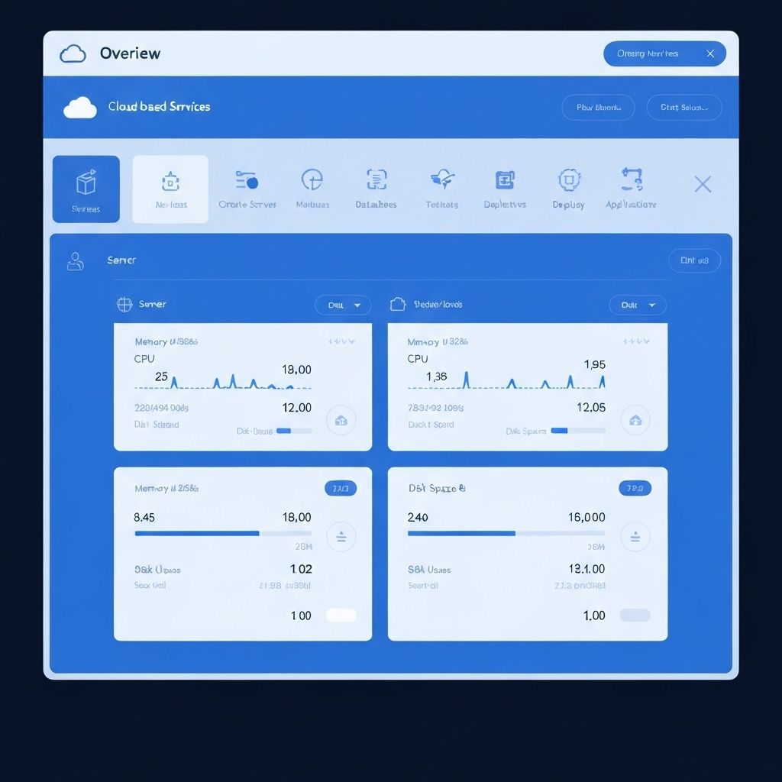
Hackathon Presentation
Introduction
CloudOps
Decision Copilot
A human-in-the-loop AI assistant for safer cloud operations decisions.
Team Members
1
Akshita Modi
2
Mrunali Manohar Vaidya
3
Khanh Duy Bui
4
Sunishi Hegde
01

Slide 2
Track 3: Human-in-the-Loop AI Assistant
CloudOps
Decision Copilot
An AI assistant that turns cloud metrics and runbooks into safe, human-approved action paths.
Metrics
CSV/JSON
Runbooks
Docs
AI
Reasoning
Human
Approval
02

Slide 3
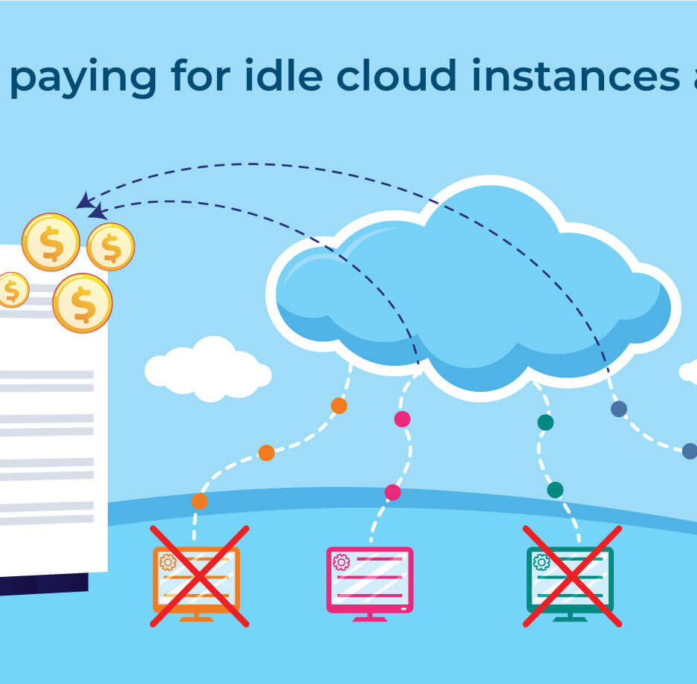
The problem: cloud signals overwhelm junior ops teams
CloudOps Decision Copilot
Making the wrong cloud action can affect uptime, cost, or security.
Too many inputs
CPU, memory, network, disk, tags, alerts, idle time, production flags, costs, and runbook rules all arrive together.
Too much risk
Stopping or deleting the wrong resource can cause application downtime or create security gaps.
Too little guidance
A junior engineer needs explainable paths, not just a single black-box answer.
03

Slide 4
Solution: recommend action paths, but never execute blindly
CloudOps Decision Copilot
The AI explains, ranks, and logs. The human decides.
Approve
Edit
Reject
Cloud metrics
CSV / JSON
Runbook docs
CRUD
Reasoning
agent
3 paths +
pros / cons
Output example
"Idle VM detected: low CPU, no network traffic, tagged dev. Recommended path: stop instance after owner approval."
Mock action only: no live cloud execution in MVP.
04

Slide 5
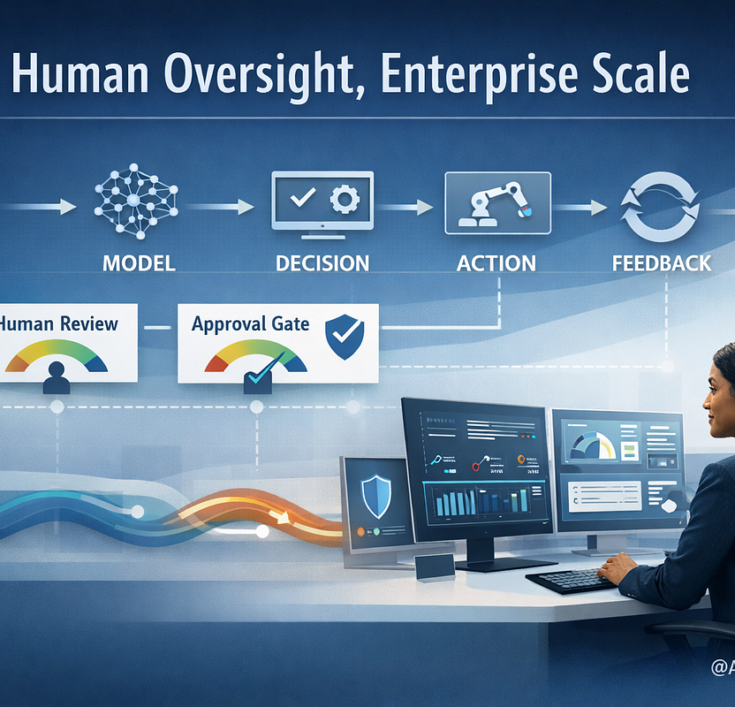
Core workflow: a controlled loop, not a one-way automation
CloudOps Decision Copilot
Every recommendation comes back to a human approval gate.
1. Request
+ docs
2. AI draft
recommendation
HITL
4. Mock action
+ log
3. Approve /
Edit / Reject
The system improves the next suggestion based on the user decision and action log.
05

Slide 6
Recommendation design: three paths for one cloud problem
CloudOps Decision Copilot
The agent gives options, trade-offs, risk labels, and steps.
Path A: Cost save
Path B: Stabilize
Path C: Investigate
Stop idle VM
Resize / schedule
Ask for more metrics
Risk: Low
Risk: Medium
Risk: Needs info
1. Confirm non-prod tag
2. Notify owner
3. Stop instance
4. Log action
1. Check trend
2. Right-size CPU/RAM
3. Add schedule
4. Recheck in 24h
1. Ask for owner tag
2. Request 7-day usage
3. Verify dependency
4. Re-run advice
Pros: immediate savings
Cons: may delay dev work
Pros: safer than stop
Cons: slower savings
Pros: avoids blind action
Cons: no immediate action
06

Slide 7
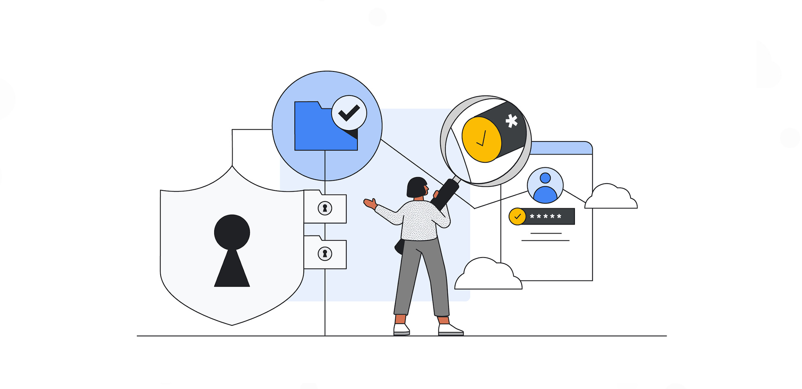
Trust and safety are product features, not add-ons
CloudOps Decision Copilot
Guardrails make the assistant usable for real operations workflows.
Safety promise: AI can recommend. Only a human can finalize a mock action.
This directly addresses the hackathon requirement for safety checks, logging, and human review.
1
2
3
4
PII warning
Risk label
Approval gate
Block action
flags secrets, keys, customer data
low / medium / high per path
approve, edit, or reject
refuse unsafe delete-prod requests
07

Slide 8
CloudOps Decision Copilot
Demo script: one success path and one safe failure path
A short live demo can prove value without connecting to real cloud accounts.
Success demo
Idle VM
found
Recommend
stop
Approve
Mock
action
Logged
Safe failure demo
"Delete
production"
High-risk
label
Refuse /
block
Ask for
metrics
Logged
Expected audience takeaway: the agent is useful because it knows when not to act.
08

Slide 9
MVP scope: simple, demoable, and aligned with requirements
CloudOps Decision Copilot
Build the minimum loop first, then improve recommendation quality.
Core components
Mock metrics sample
1
Request + document CRUD
resource_id, env, cpu_avg, mem_avg, net_in, cost_day
ec2-dev-04, dev, 2%, 11%, 0.1GB, $4.20
ec2-prod-01, prod, 68%, 74%, 14GB, $31.90
rds-test-02, test, missing, 22%, 0GB, $18.10
user can enter tasks and update runbooks
2
Mock metrics ingestion
CloudWatch-style CSV / JSON input
3
Reasoning agent
explain metrics + 3 action paths
Approval loop
Agent output format
4
approve / edit / reject before finalization
Summary -> 3 paths -> risk label -> steps -> pros/cons -> approval prompt -> log event
5
Action log + warning
records every step and flags sensitive info
09

Slide 10
48-hour build plan: get to a convincing live demo
CloudOps Decision Copilot
Focus on the experience judges can understand in under five minutes.
0-6h
6-18h
18-30h
30-42h
42-48h
1
2
3
4
5
Validate + data
App shell
Agent loop
Safety + approval
Polish demo
Finalize user story, create mock metrics, draft runbooks
Upload/request UI, document CRUD, simple log view
Generate 3 action paths with risk labels and pros/cons
PII warning, high-risk block, approve/edit/reject flow
Success + failure script, slides, judging story
Final hackathon deliverable: a working human-in-the-loop demo that recommends safe cloud actions, blocks risky requests, and logs every step.
10

Slide 11
Q & A
Thank you
Questions, feedback, and judging discussion
Cloud metrics
3 safe paths
Human approval
CloudOps Decision Copilot
11

